Slide 1

Cryptology
The art of
secret messages

Slide 2

Cryptology is the art and science of “secret” writing and data transmission security. The word comes from the Greek word kryptos, which means ‘hidden’ and logos, which means ‘word’. It is the branch of science that deals with secret communications.
Often messages need to be transmitted secretly ~ but how can one guarantee that data arrives safely in the right hands without being heisted?
This presentation looks at one type of mathematically-based encryption system. This is an introduction to the application of cryptography using the Hill Cipher.

Slide 3
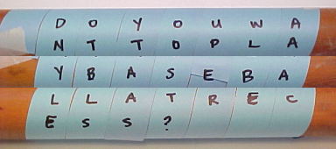
Thousands of years ago man began devising systems to communicate in secret. One of the oldest known examples is the Spartan scytale.
Used over 2500 years ago by the Spartan government, each sender and recipient had a
cylinder - called a scytale - of exactly the same radius. The sender wound a narrow ribbon of parchment around the cylinder and wrote on it lengthwise. After the ribbon was unwound, the writing could be only be read by a person who had a cylinder of exactly the same circumference.

Slide 4
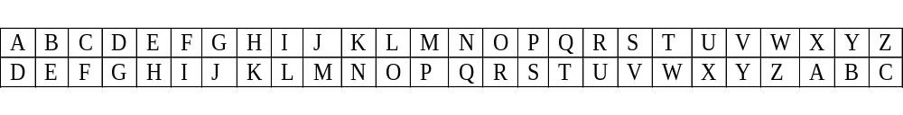
Caesar Cipher
The first known military use of a cipher occurred around 50-60 BC during Julius Caesar’s reign. The Caesar Cipher is the simplest of substitution ciphers. It replaces each message character with the letter that is three letters ahead in the alphabet.
The two alphabets are shown one above the other:
The plaintext characters - top row - are replaced with the characters on the bottom row. Therefore, “LINEAR ALGEBRA” becomes OLQHDU DOJHEVD.
A fun transformation using the Caesar Cipher is from the movie 2001: A Space Odyssey. With a one-letter shift to the right the computer named “H-A-L” becomes I-B-M.

Slide 5
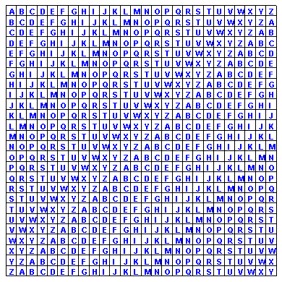
Vigenere Square Cipher
This cipher uses a key letter, for this example, V. To encipher the text “END OF CLASS” take the first letter of the text E and find the column beginning with it. Find the row beginning with the key letter V and find the intersection of these two, which is Z.
The key letter shifts with each letter encoded. The next key letter is E, the first letter of the plain text. Take column N and row E, then column D and row N. Look at the the Vigenere Square and see how the sequence is completed:
END OF CLASS
ZRQ RT HNLSK
It turns out that this
type of cipher has the
property of perfect security!

Slide 6

Pigpen Cipher
The users of this cipher memorized this code shown below:
Here is a sample cipher:
This decodes into the phrase “USED BY FREEMASONS”

Slide 7
A few definitions to know:
Cryptography or cryptology is the design and analysis of hidden or encoded information. The message may be public such as internet transactions or secret.
Cryptanalysis is the activity of “breaking” the code to recover the information from the coded message.
Code is a set of words or symbols that will be used to replace and transform the message
Encipher is to encode or scramble the information with a system for transforming the message into the secret one, also known as encryption
Attack is an ‘unintended recipient’s’ attempt to break and read a cipher

Slide 8
Other definitions
Ciphertext or cipher is the encoded information
Decipher or decryption is the action by the legitimate party of taking the ciphertext and transforming it into plaintext
Plaintext is the original message to be encoded or recovered
Transposition – a cipher that keeps the same letters as the original message but changes their order
Substitution a cipher that changes the letters in the message. The most famous substitution cipher is the Caesar cipher

Slide 9
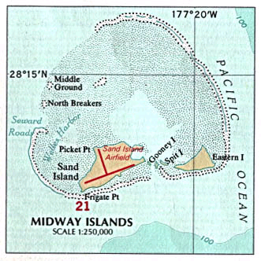
Notable history in the development of Cryptology
Prior to America’s official entry into W W II, the American Combat Intelligence had been working feverishly to break the Japanese military code known as JN-25B. The encryption was still not solved after the devastating stealth attack on Pearl Harbor in 1941. We knew an attack was forthcoming at a place known as “AP”, possibly at Midway, but our military needed to know the location for certain. American forces brilliantly
Broadcast a dummy message that complained of a “water shortage” at Midway. The next Japanese communication repeated the water shortage message along with the code of “AP” for Midway and so the encryption system was solved. This success helped to ensure an Allied victory at the Battle of Midway.

Slide 10
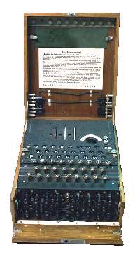
Enigma & World War II
Electro-mechanical encryption machines were common by the early part of the twentieth century. One famous device called THE ENIGMA was used by the Germans during W W II. It was a fairly complicated encryption machine with many gears, keys and lights,
and it worked by using substitution ciphers to encode messages. The architects of the code shifted the ciphers one letter each time a new letter was encoded. This minimized the chance that the frequency of certain letters appearing in the code could be used to break it. (Frequency of letter occurrence is an important deciphering technique but we will not treat it here.) In fact the messages generated by ENIGMA machines were often deciphered by the savvy Allied intelligence during the War. Many credit this feat of cryptanalysis with shortening the conflict and saving many lives.

Slide 11
The Hill Cipher
The link between mathematics and cryptology became obvious in a paper published in 1929 by Lester Hill. His idea was to encipher using a linear transformation of blocks of letters. We will see how a simple form of this encryption system works by using elementary linear algebra for the process that generates the Hill Cipher.
Whether for fun or for security reasons, there is a need for cipher text that offers perfect security – it is virtually impossible to decrypt. This requires more complicated code. The Hill Cipher accomplishes this by using a matrix to transform the message.

Slide 12
Properties of the Hill Cipher
The goal is to encode the letters by blocks and make them unintelligible. Of course it should not be apparent how this letter assignment is done or the message would be too easy to decipher.
The letters are first treated as numbers so they can be mathematically manipulated. For this demonstration the A-to-Z letters will be assigned integers 0-to-25.
We will reduce any number > 25 (greater than 25) by using modular math. The modular function replaces a value with a remainder - we will look at how this works.
For this demonstration the letters of the text will be handled in groups of two, for example “unit” = UN and IT. This will enable us to place them into matrices with 2 rows (2 x n matrices).
The Hill Cipher uses matrix multiplication to perform the transformation, and multiplication by an inverse matrix to undo the operation and recover the text. The matrix transformations we use will have their elements and operators adjusted so they are integers from 0-to-25.

Slide 13

Modular Mathematics
To appreciate the matrix manipulation by the Hill Cipher, a basic understanding of modular math is helpful.
When an equation or number or matrix is adjusted by a modulus or mod, the effect is to tweak it by division but represent it by a remainder. An example will help to illustrate this. The equation:
Reads that “12 is congruent to 2 modulo 5” (or mod 5). This is the same as noting that 5 divides 10: (10 = 12 – 2). Another way to look at this is that 12 divided by 5 gives a remainder of 2.

Slide 14
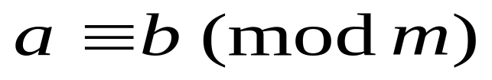
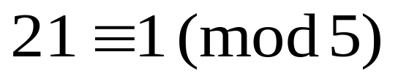
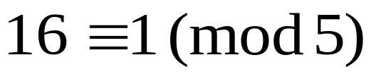
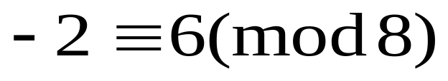
The mathematical notation for this is:
Where m > 0
“a is congruent to b mod m” and m divides (a-b). More examples:
←Note:
16 + 5 = 21 and these two are congruent to 1 (mod 5)
8 divides (-2 - 6) →
We will look at matrices and their inverses (modulo m) when we are at the point of deciphering the message.

Slide 15
Requirements for the Hill cipher matrix
There are some considerations when choosing the encoding matrix. This matrix is usually derived through the guess and check method.
Determinant
The determinant of the encoding matrix must be a number other than 0 that is relatively prime to 26. This means that it can’t be an even number since 2 is a factor of 26. For the same reason it cannot be 13. We will look at a these possible values in Table II.
Multiplicative Inverse
For a real number ¹/_{a} (given that a does not equal zero) the number ¹/_{a} is the multiplicative inverse of a so that ¹/_{a} x a = 1. ¹/_{a} can also be noted as a⁻¹, so (a⁻¹ x a = 1). For our purposes, this inverse will be another matrix. This matrix must be invertible modulo 26.
Matrix Multiplication
The product of a matrix multiplied by its inverse will be the identity matrix [1,0; 0 1]

Slide 16
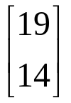
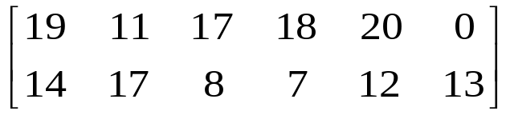
Let’s use the Hill cipher system to encrypt the plaintext “TO ERR IS HUMAN”.
We need to assign a number to represent each letter of the alphabet. For this use:
Table I
A B C D E F G H I J K L M
0 1 2 3 4 5 6 7 8 9 10 11 12
N O P Q R S T U V W X Y Z
13 14 15 16 17 18 19 20 21 22 23 24 25
Separate the message into pairs of letters and replace each
letter of the plaintext with its corresponding number.
So, letters: T = 19 and O = 14, etc. Arrange these as:
Here it is displayed as a 2x6 matrix:
TO ER RI SH UM AN
becomes:

Slide 17
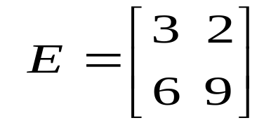
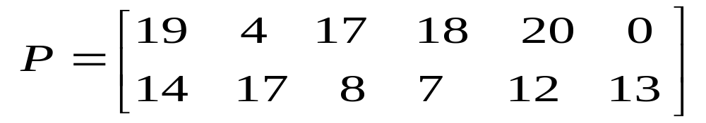
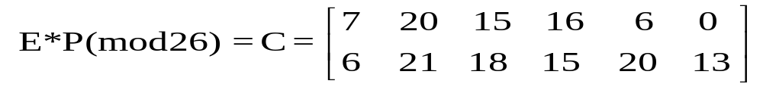
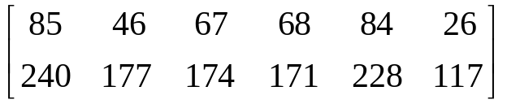
Select a 2x2 encoding matrix that is invertible (mod 26) to encode the plaintext matrix P. Our matrix E will be [3,2; 6,9]. Multiply matrix E by matrix C; this can be performed by hand or using Matlab and the mod function: C = mod ( E * P, 26)
Remember, when choosing matrix E, select one that the det(E) ≠ 0
Note: If we multiply E*P and don’t (mod 26) we get:
These numbers are > 25 and not within the Table I values, so we need to reduce them to a remainder by modulo 26.

Slide 18
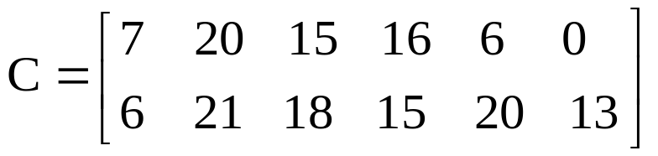
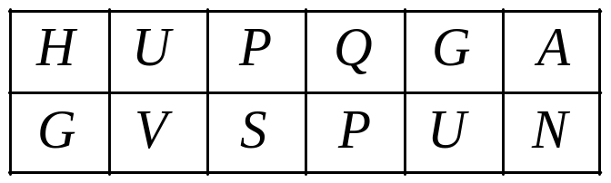
Using Table I, substitute letters for the elements of matrix C and generate the cipher text
Table I.
A B C D E F G H I J K L M
0 1 2 3 4 5 6 7 8 9 10 11 12
N O P Q R S T U V W X Y Z
13 14 15 16 17 18 19 20 21 22 23 24 25
Becomes:
It is then rewritten as the ciphertext HGUVPSQPGUAN, and our encoded message is ready to send.

Slide 19
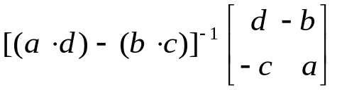
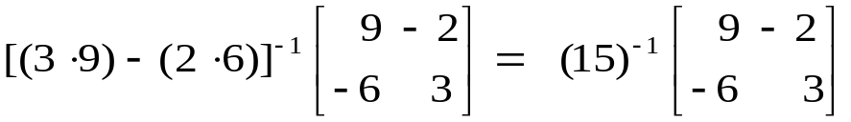
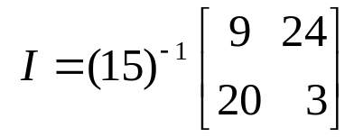
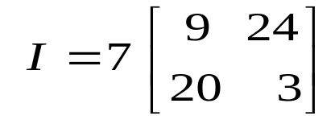
Deciphering The receiver of this ciphertext needs an inverse matrix to decipher the message.
Finding the Inverse The inverse of the 2x2 matrix is found in the usual way except that we need to modify it by the (mod 26) function. This will be easiest to see by actually finding the inverse.
Inverse Function =
=
of
We are only using the number set 0-25 so we must adjust this answer by (mod 26) for any number not within that range. We can see that (-2) becomes 24 and (-6) becomes 20. We can mod this now or later – since the mod produces a remainder it can be repeated without affecting the ultimate result. It is a bit more complicated to convert (15) ⁻¹ to a value from 0-25.
← (15) ⁻¹ becomes 7 →

Slide 20
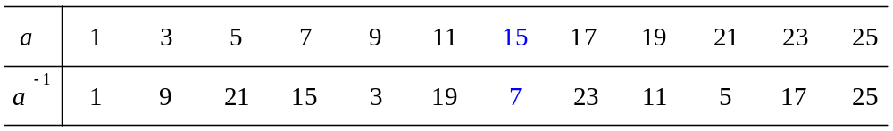

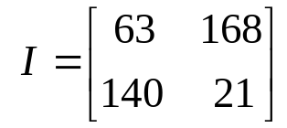
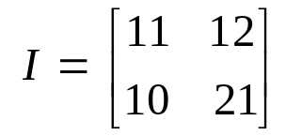
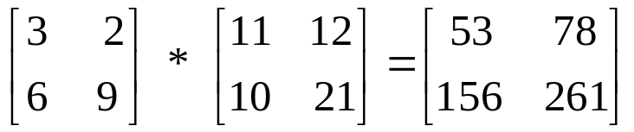
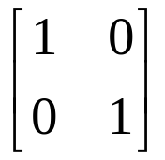
These conversion values are computed by finding the number a that is multiplied by a ⁻¹ to get a remainder of 1 after (mod 26). In our matrix, 15 * 7 (mod 26) = 105 (mod26) = 1.
Table II.
Substitute the inverse of 7 for 15 ⁻¹ in our matrix I.
Multiply by 7 and our matrix becomes:
Once again we will (mod 26) to reduce the numbers >25. The inverse matrix at last →
Let’s check by multiplying (E * I ):
←(mod 26) one more time →

Slide 21
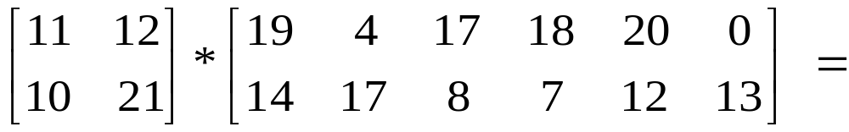
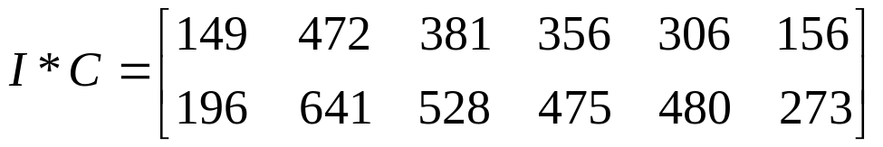
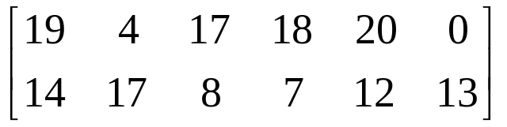
Apply the inverse matrix and verify that it works to decode the ciphertext. Multiply I x C:
As the numbers returned are > 25, adjust this matrix by (mod 26).
Note: In Matlab, we can perform this by the command mod (I * C, 26) without any spaces – they are shown here for legibility.

Slide 22
Using Table I we now substitute letters for the numbers.
Table I.
A B C D E F G H I J K L M
0 1 2 3 4 5 6 7 8 9 10 11 12
N O P Q R S T U V W X Y Z
13 14 15 16 17 18 19 20 21 22 23 24 25
Verify that:
19 = T, 14 = O, 4 = E, 17 = R, 17 = R, 8 = I, 18 = S, 7 = H, 20 = U, 12 = M, 0 = A, and 13 = N.
Reconstructed, this does indeed return the original message
“TO ERR IS HUMAN”

Slide 23
The cipher and decipher of our message is now complete. We have seen how Linear algebra can be used to encode and decipher a Hill Cipher in blocks of two letters, utilizing matrix multiplication, modular math, and inverses.
This relatively simple system can be applied with ease and enjoyed by everyone with a bit of knowledge of number operations. The ciphers can be made more secure with some extra effort by using 3-row matrices.
☺

Slide 24
IOIOIOIOIOIOIOIOIOIOIOIOIOIOIOIOIOIOIOIO
IOIOIOIOIOIOIOIOIOIOIOIOIOIOIOIOIOIOIOIO
IOIOIOIOIOIOIOIOIOIOIOIOIOIOIOIOIOIOIOIO
IOIOIOIOIOIOIOIOIOIOIOIOIOIOIOIOIOIOIOIO
IOIOIOIOIOIOIOIOIOIOIOIOIOIOIOIOIOIOIOIO
IOIOIOIOIOIOIOIOIOIOIOIOIOIOIOIOIOIOIOIO
IOIOIOIOIOIOIOIOIOIOIOIOIOIOIOIOIOIOIOIO
IOIOIOIOIOIOIOIOIOIOIOIOIOIOIOIOIOIOIOIO
IOIOIOIOIOIOIOIOIOIOIOIOIOIOIOIOIOIOIOIO
IOIOIOIOIOIOIOIOIOIOIOIOIOIOIOIOIOIOIOIO
IOIOIOIOIOIOIOIOIOIOIOIOIOIOIOIOIOIOIOIO
IOIOIOIOIOIOIO
Happy Encoding, Krista Martens
IOIOIOIOIOIOIO

